Slide 1
Project guidance

Slide 2
ENGLISH
XIN HUA EVENING SECONDARY SCHOOL 2013-2014 SECOND TERM
FORM Four ( )
Old Macao and Present Macao
Submitted on 30th, October, 2015
Presented by Amy Leong

Slide 3


Slide 4
Introduction
Old Macao and Present Macao
In the past decades, there are many changes in Macao. There are more and more people in Macao and more visitors coming here too. I am going to show three parts of the changes below.
1). Senado Square
2). The Border Gate
3). Lam Mau Pond

Slide 5
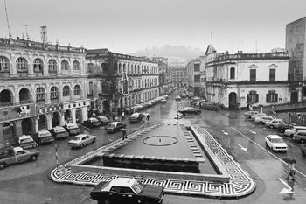
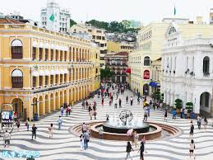
This is Senado Square. The left picture was in the 1960s. There were many cars parking there but now it is the car-free area. And it has become a landmark of Macao. There are much more tourists than before.

Slide 6
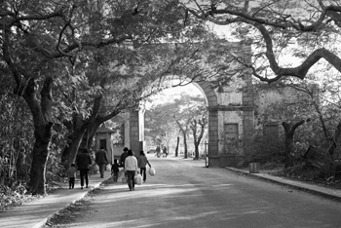
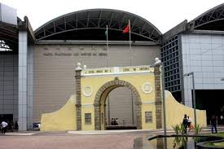
The Border Gate
The old Border Gate is more different from the present one. Before there were some trees on both the road sides. Now there are no any trees at all around the modern Border Gate. It is the most busiest border gateway in Macao. Thousands of people come
and go through the Border Gate every day.

Slide 7
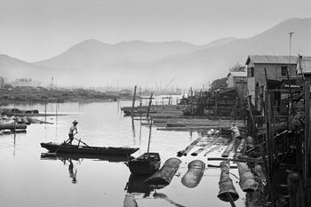
Lam Mau Pond
This is Lam Mau Pond. Before, there were many fishermen living there and they went along the island by boat. There
were simple wooden houses on the bank and they were home of many fishermen. Now there are no any fishermen
at all. Since 1998, a Yacht Club was established and there
are more than 80 yachts at one time parking there.
On the bank of the pond, we can see
many modern buildings.

Slide 8
Sources
https:// www.MACAUOLDMAP.COM
https://www.corner06.com/uncategorized/national-oversea-bank-avenida-do/
(End)

